Slide 1


Slide 2

“Final review of Mini Project”
for E-3 2017 Admitted Batch
Submitted as part of Mini Project.
P. Purna -- ID. No: S170478
B. Lilly Grace -- ID. No: S170082
K. Prasad -- ID. No: S170073
Under the Supervision of:
Ms. Roopa Musidi
Assistant Professor, Dept of CSE
Department of Computer Science and Engineering
Rajiv Gandhi University of Knowledge Technologies
Srikakulam – 532402
Email: dileep@rguktsklm.ac.in

Slide 3

Team Details
Ms. Roopa Musudi (Ass.Prof) (Project Guide)
Panchireddy Purna (S170478) (Team Member)
Kornu Prasadrao (S170073) (Team Member)
Bhimuni Lillygrace (S170082) (Team Member)

Slide 4

RGUKT HOSPITAL MANAGEMENT SYSTEM
To
RGUKT HOSPITAL MANAGEMENT
SYSTEM

Slide 5
Presentation Outline :-
Introduction
Abstract
Motivation of Project Work
Scope of project
Analysis of Existing models
Proposed System
Requirement analysis and Specification
System design
Implementation
Testing
Conclusion

Slide 6
Introduction
Hospital Management System already existed in many hospitals on different parts of India. Many organisations and High-tech hospitals uses this to preserve the data history of the students. Many colleges and small organisations are not aware of it. One such issues was addressed in my college too.
The issues which were addressed are Unavailability of doctors/medicines etc..., He has to explain his problem as many times as he goes to hospital. To overcome those problems our aim is to provide a platform where all the issues will be clarified by maintaining all the histories of student’s health details, medicines etc… which will be stored in a website.

Slide 7
Abstract
Hospital management system is a computer system that helps manage the student’s information, diagnosis. It includes a search facility to know the current status of each student. Student can search their details by using their credentials. The Hospital Management System can be entered using a username and password. It is accessible by either an administrator or receptionist. Only they can add data into the database. The data can be retrieved easily. The interface is very user- friendly. The data are well protected for personal use and makes the data processing very fast. It captures and stores the medical history, treatment required, details of their previous visit.

Slide 8
Motivation of the Project
The real motivation for the hospital management system project is to make easy process of all the management processes like students registration, doctors appointment, doctors prescription, etc.
We always see that to find out the student’s history, the he/she has to go through various registers. This results in wastage of time. So by using this system it will become easy to manage all processes.
The motivation of this scenario which was regularly done in hospitals we are designing this system which can be benefited for the students and hospital staff. So, we'd like to possess this system which help hospital to do work fast and effective.

Slide 9
Scope of the Project
The Software product "HMS" will be an application that will be used for maintaining the records in an organized manner by replacing old paper work system and adding new features, improving the existing features as well.
This project aims at automating the hospital management for smooth working of the hospital by automating almost all the activities. Updating and modifications will be easily achievable and taking appointment of doctor gets much easier.
If the hospital management system is file based, management of the hospital has to put much effort on securing the files. They can be easily damaged by fire, insects and natural disasters. Also could be misplaced by losing data and information.

Slide 10
Analysis of Existing Model
At present there is no software for RGUKT hospital management
Students need to come to hospital to check whether doctor is present or not.
Students details and prescriptions are carried out manually
Lack of security for the records, anyone disarrange the records of our system
If someone want to check the details of the available doctors the previous system does not provide any necessary details of this type.

Slide 11
Proposal System
Replaces the old paper based system.
Store large amount of data in secure manner
Easy to retrieve the data about student
Students no need to come to hospital to check whether doctor is present or not.
Doctors can prescribe the medicine in the website itself.
It manages patient appointments and prescribed medicines.

Slide 12
Results and Analysis
Student can easily access their details when he want. Because here we are using PHP and MySQL which place a major role to store database of the students in systematic manner.
The details of student are in secured way because here we are using Hashing Technique to provide security.
Here password is not visible to anyone even admin also can not access the passwords of students.
System design

Slide 13
Requirement analysis and Specification
HARDWARE REQUIREMENTS
RAM: 5GB
ROM: 512
PROCESSOR: AMD A9 DUAL CORE
SOFTWARE REQUIREMENTS
backend: MYSQL , PHP
frontend: JS, HTML , CSS,
Operating SYSTEM: WINDOWS -10

Slide 14
System design
The system design is divided into four sections:
Student section
Doctor section
Pharmacist section
Admin Section

Slide 15
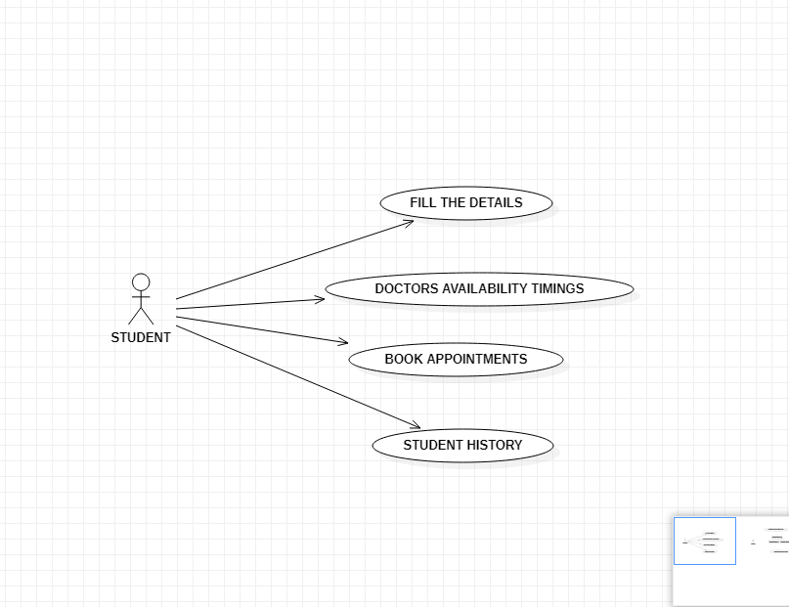
System Design Use case Diagram for Student

Slide 16
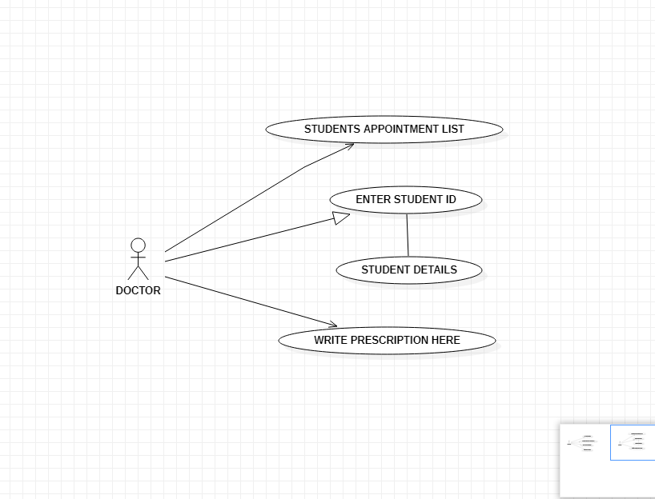
System Design
Use case Diagram for Doctor

Slide 17
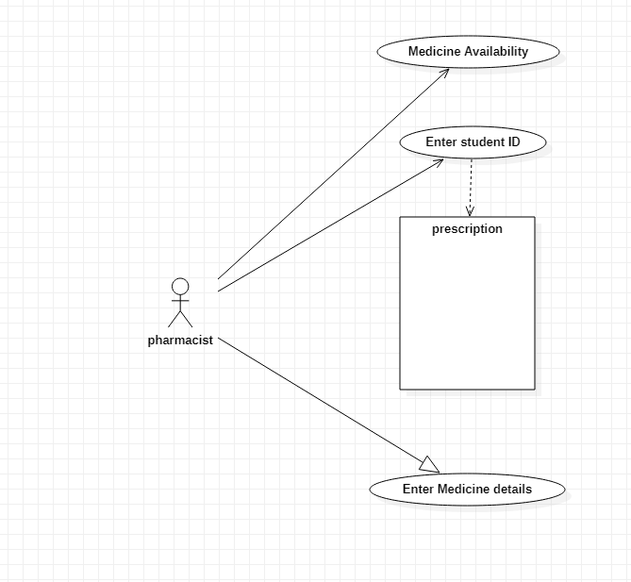
System Design Use case Diagram for Pharmacist

Slide 18
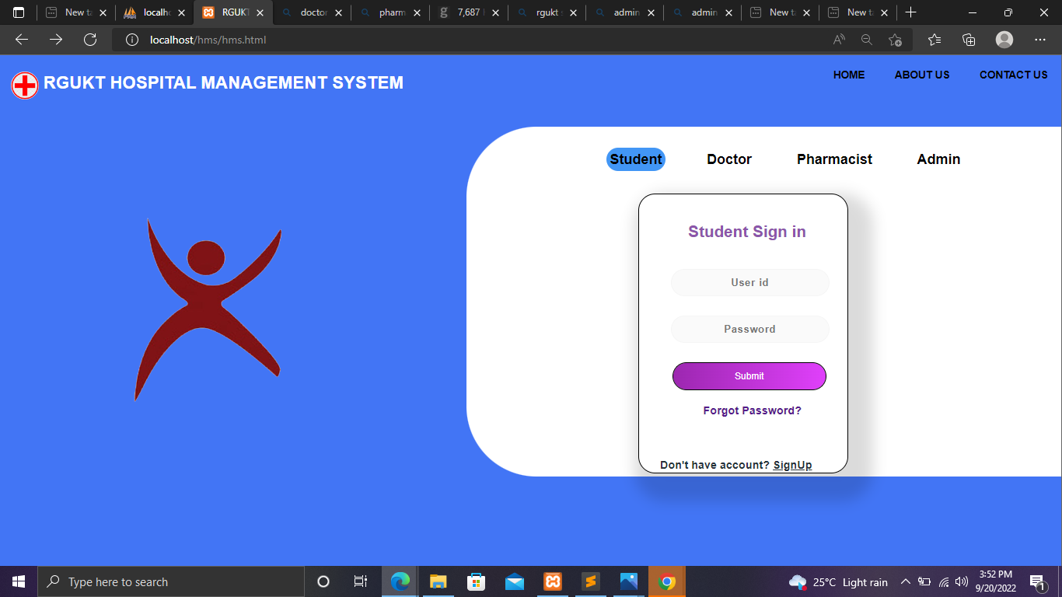
Implementation

Slide 19
The steps from when student enter into hospital to he/she leaves from the hospital :-
Then go to “Sign – In” and enter ID and Password. So now open “Student dashboard” .
Click on appointment and enter details -> take appointment. Show doctor availability timings.
Now login as doctor -> appointment list -> click on ID number -> Write Prescription.
Now login as Pharmacist -> Patient details -> Provide prescribed Medicine to student-> click on submit
Go to medicine history -> here we saw the medicine which is given to student.
Now login as Admin -> when new doctor is added then go to -> add doctors -> enter doctor details
Now login as student and go to student history and watch his previous visited details.

Slide 20
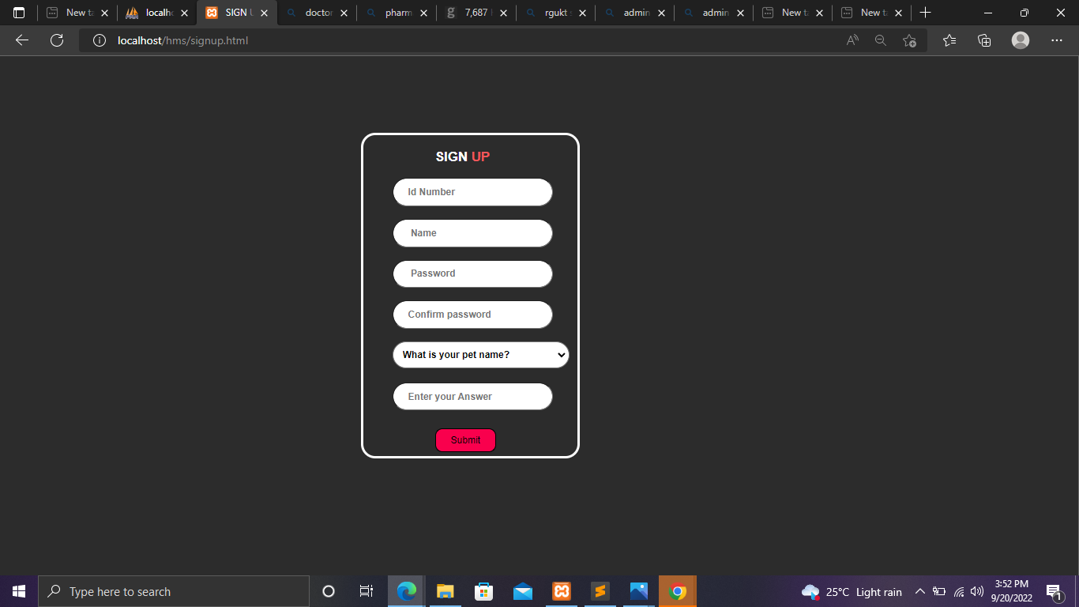
Home Page -> Student -> If you do not have account then go to “Sign –Up” and enter your details.

Slide 21
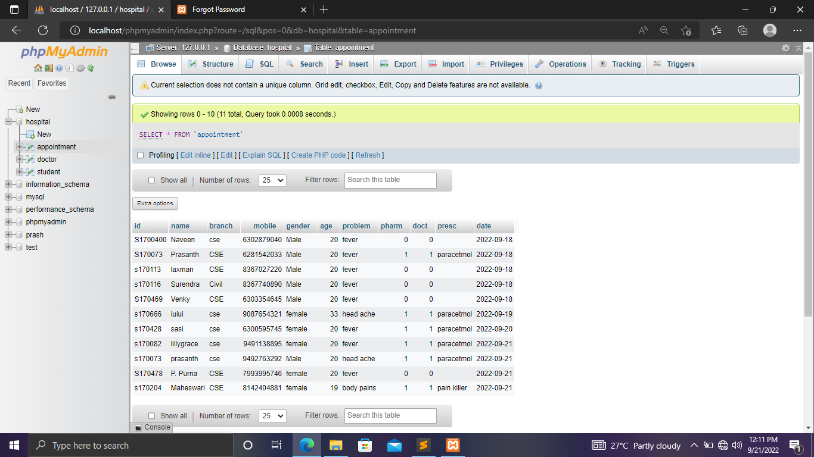
After registration the data of the student what he/she entered is going to store in the hospital database. (As shown in below image)

Slide 22
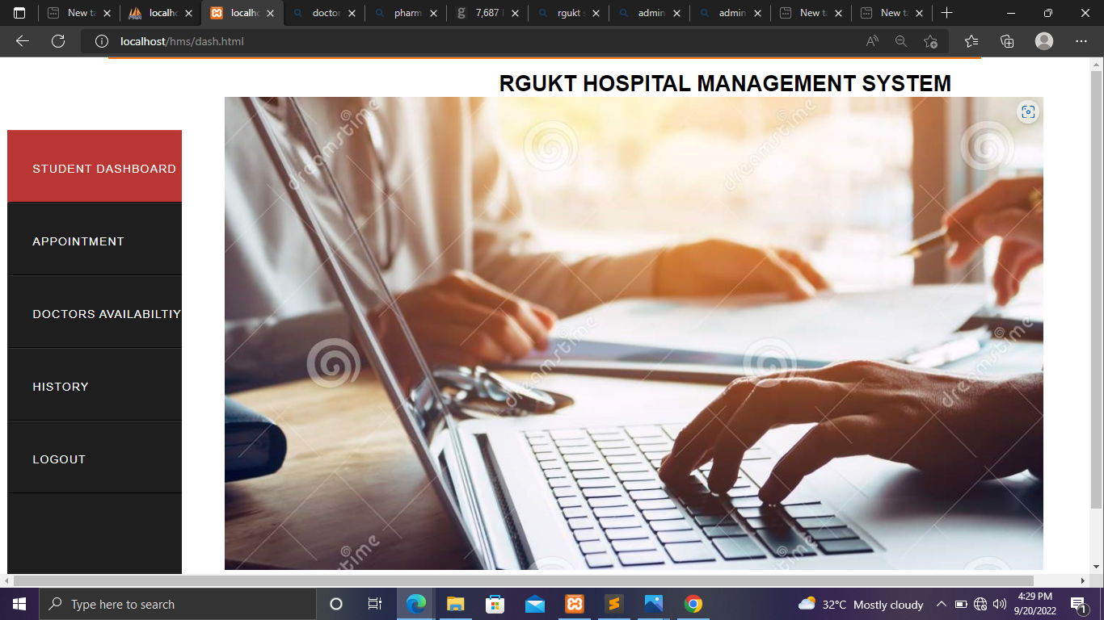

Slide 23
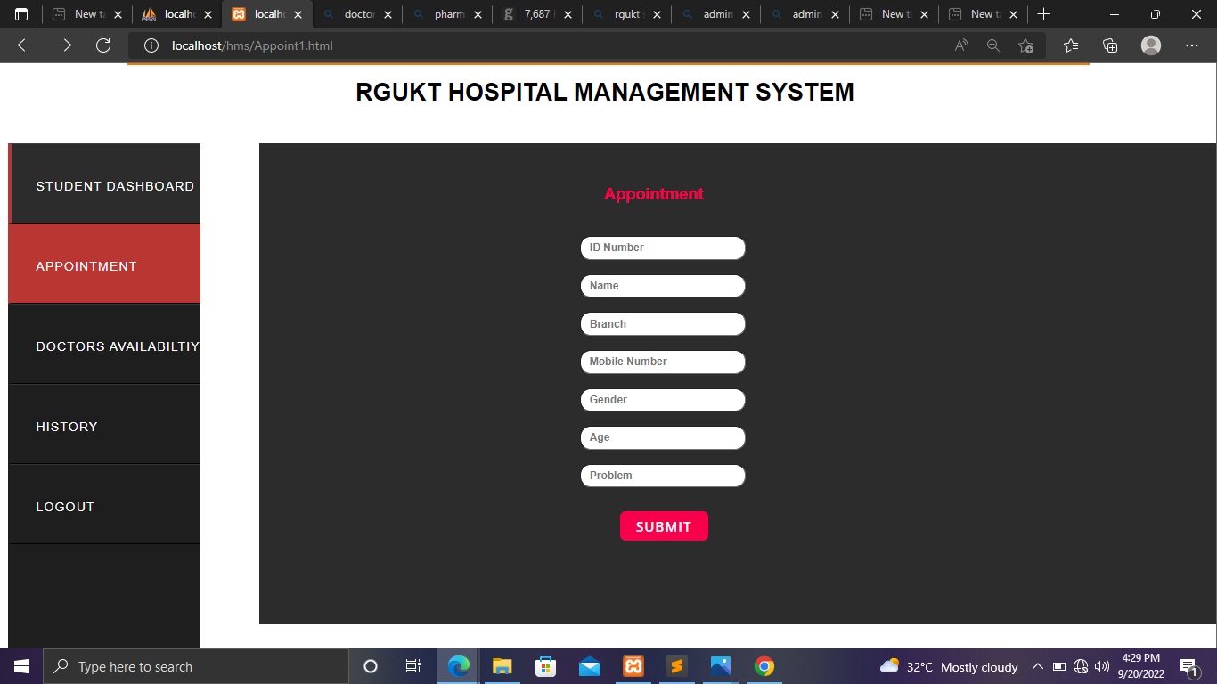
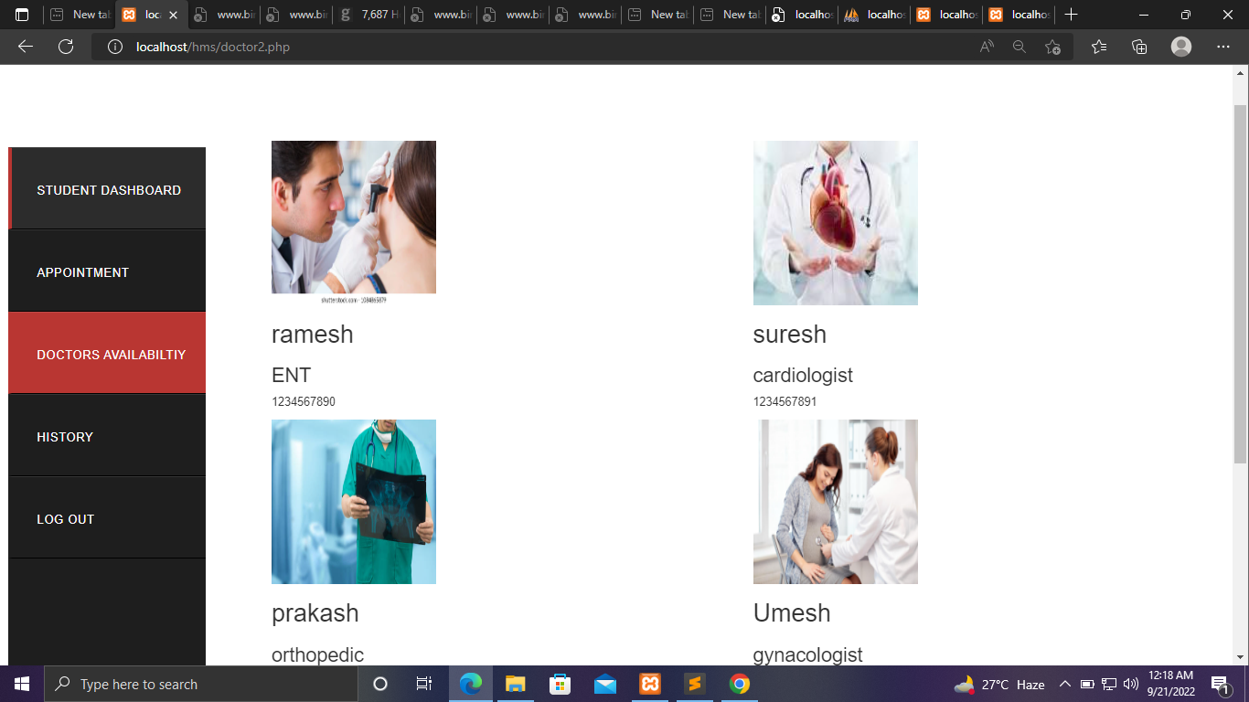
Click on appointment and enter details -> take appointment. Show doctor availability timings.

Slide 24
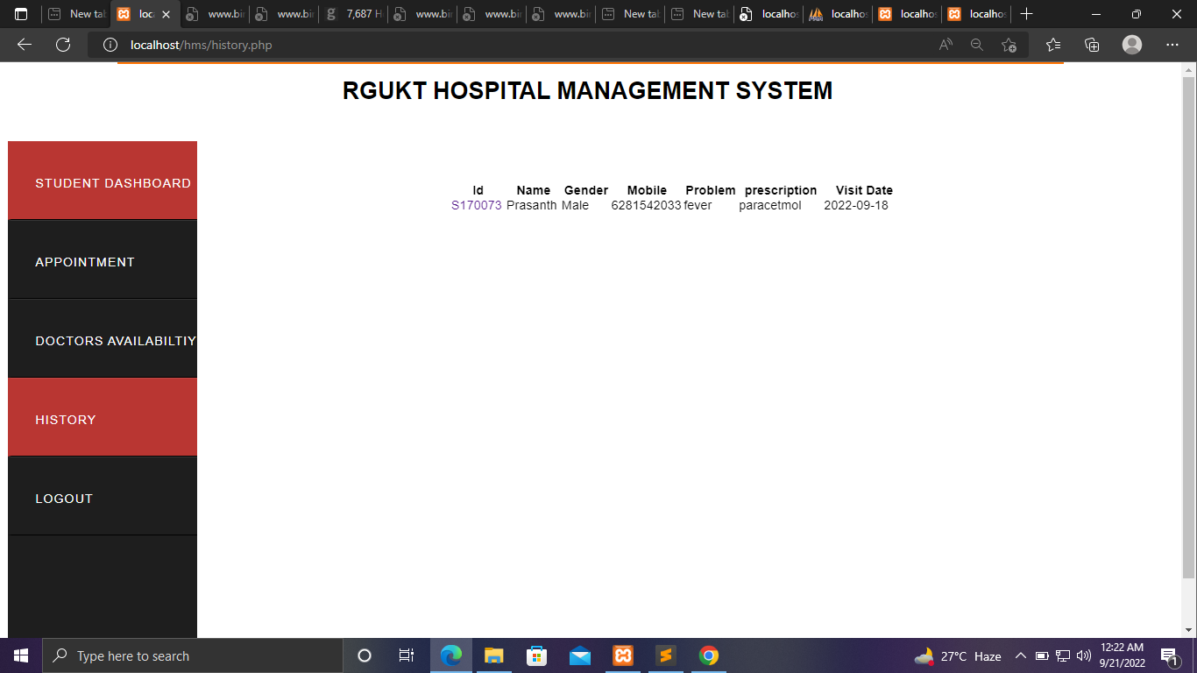
Now login as student and go to student history and watch his previous visited details.

Slide 25
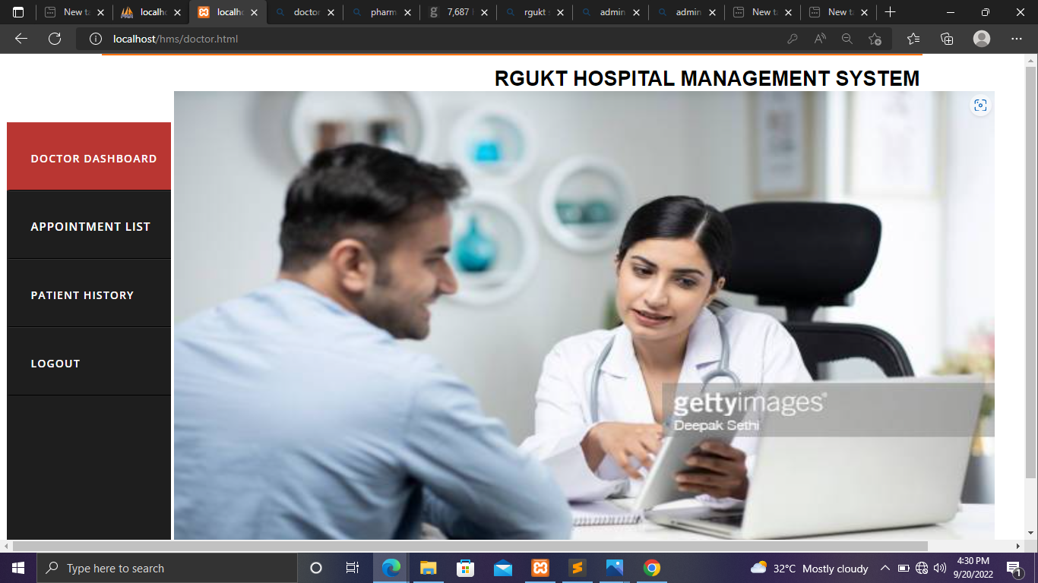

Slide 26
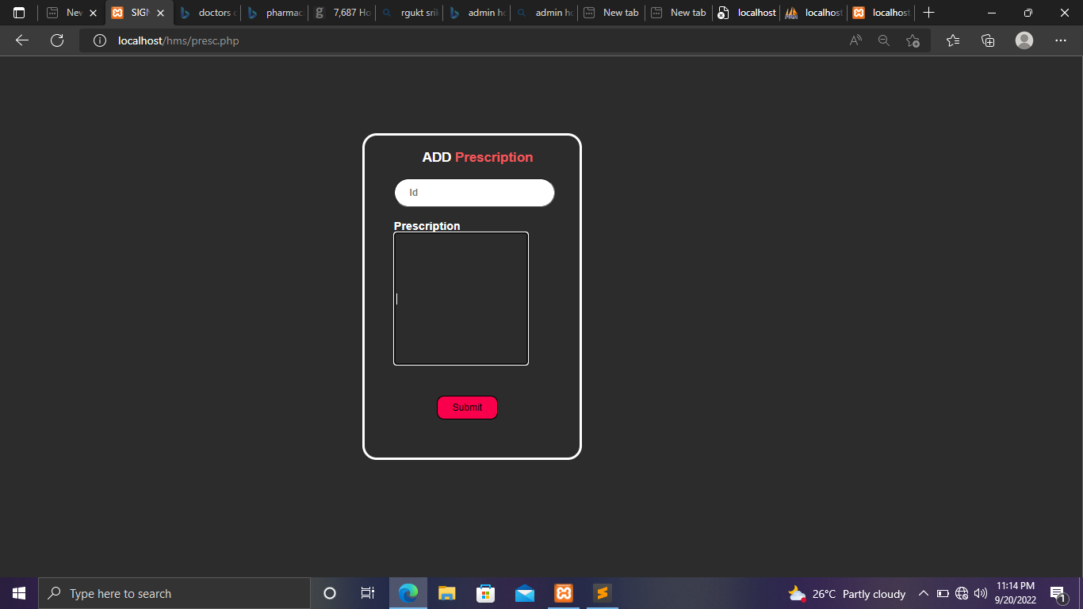
Now login as doctor -> appointment list -> click on ID number -> Write Prescription.

Slide 27
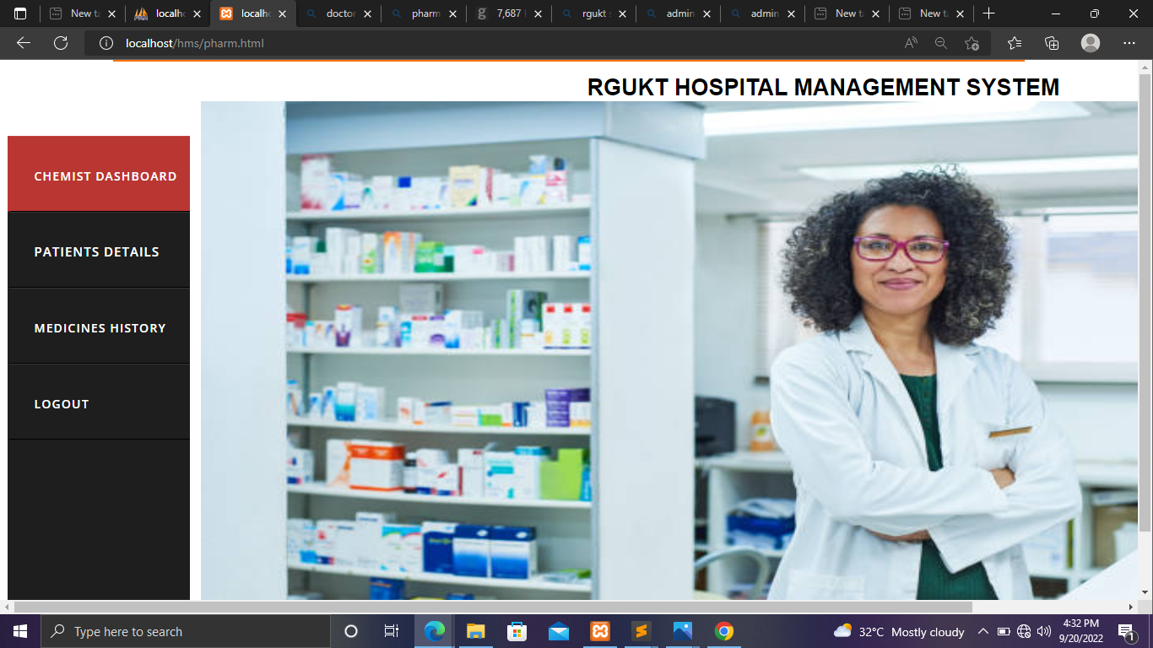

Slide 28
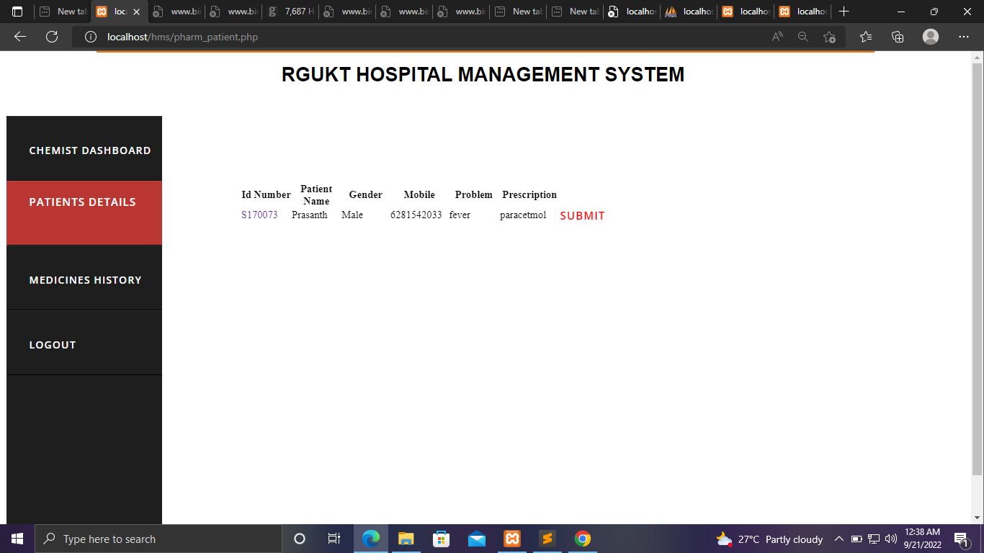
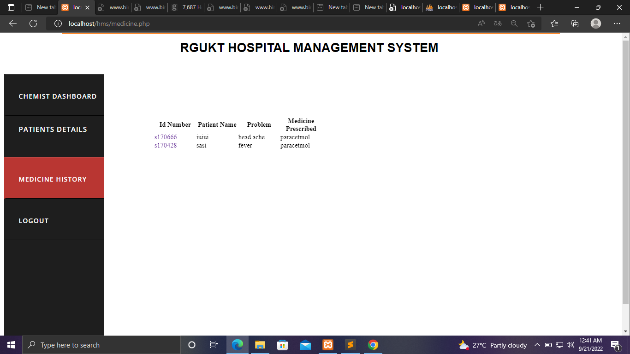
Now login as Pharmacist -> Patient details -> Provide prescribed Medicine to student-> click on submit

Slide 29
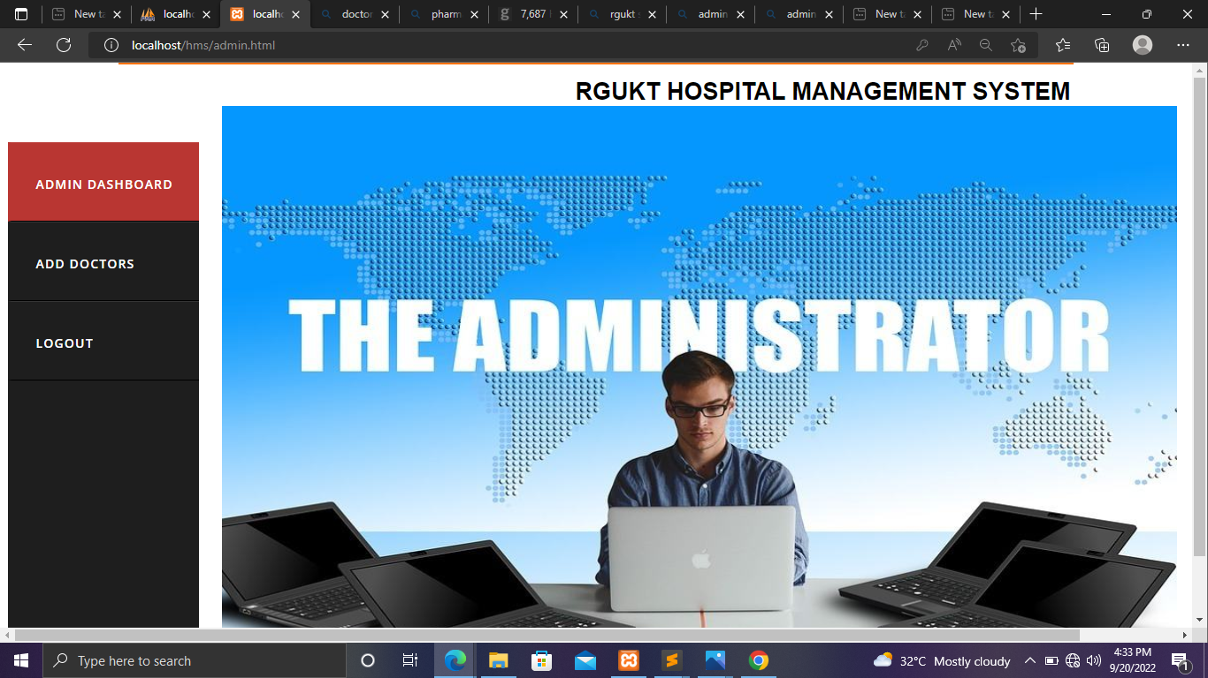

Slide 30
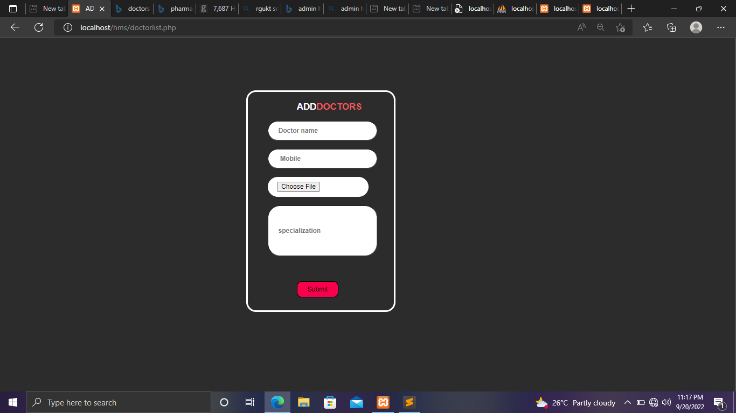
Now login as Admin -> when new doctor is added then go to -> add doctors -> enter doctor details

Slide 31
Testing
Positive test cases
S.no | Test case description | Actual Value | Expected Value | Result
1 | Enter the details of username and password to login | Logged into page | Log into page | TRUE
2 | When the doctor enter the student’s ID number then display the student details if student is already visited the hospital. | Successfully displayed | To display at corresponding student’s details. | TRUE
3 | Appointments, patient details, medicines should forward to correspond user's profile | Successfully forwarded | To display at corresponding user's profile | TRUE

Slide 32
Testing
Negative test cases
S.no | Test case description | Actual Value | Expected Value | Result
1 | Enter the details of username and password to login | Incorrect username and password | Log into page | FALSE
2 | When the doctor enter the student’s ID number then display the student details if student is already visited the hospital. | Student’s details are not displaying | To display at corresponding student’s details. | FALSE
3 | Appointments, patient details, medicines should forward to correspond user's profile | Details are not forwarding properly | To display at corresponding user's profile | FALSE

Slide 33
Conclusion
The project RGUKT - Hospital Management System (HMS)is for computerizing the working in a hospital. Using this application we can retrieve student’s history with a single click. Thus processing information will be faster. It Guarantees accurate maintenance of every student’s details.We know the current health status of the every student in the campus.The doctors can check details of the students on their system, provide prescription on a click which will be sent to the pharmacist this will reduce a huge amount of time as the pharmacist knows which medicines to be kept ready before hand, the communications among the doctor and student is enhanced as the student can get as much help online. It will help to reduce many manual efforts, time taken and cost.

Slide 34
References
https://www.myopd.in/blog/what-is-a-hospital-management-system/
https://www.engpaper.net/hospital.html
https://youtu.be/OK_JCtrrv-c
https://youtu.be/2HVKizgcfjo
https://youtu.be/7S_tz1z_5bA
https://youtu.be/G3e-cpL7ofc

Slide 35


